Slide 1

COMMUNITY SERVICES PLATFORM
SahyogRide
A community ride & seat-booking platform that replaces WhatsApp chaos
with reliable, real-time seat management.
Final Project Presentation | Team 078 | IITM Software Engineering — May 2026

Slide 2
THE PROBLEM
Community transport runs on WhatsApp chaos
In semi-urban and rural India, people struggle to reach hospitals, district offices, and essential services because reliable transport doesn't exist. NGOs and volunteer groups try to help — but coordination happens over WhatsApp: seat counts get confused, double-bookings happen, and no one knows who's actually coming.
15
distinct pain points documented
5+2
user interviews & observation sessions
“Families miss medical appointments. Elderly residents can't travel alone.”
0
reliable digital tool — before SahyogRide
SahyogRide — Team 078
02

Slide 3



THE SOLUTION
A simple, digital way to coordinate free community rides
SahyogRide is a non-commercial shuttle-booking platform. NGOs and hospitals (coordinators) publish free trips — a medical shuttle, a weekly ration-office run — and residents search, hold a seat, and confirm it digitally.
No payment required
No GPS needed
Reliable confirmation
Entirely free — built for essential, not commercial, travel
Lightweight coordination, not a tracking system
Digital proof replaces ambiguous verbal promises
SahyogRide — Team 078
03

Slide 4



USER IDENTIFICATION
Who SahyogRide is built for
Interact daily and directly depend on the platform
2
PRIMARY
Rider, Coordinator
Benefit indirectly or use it occasionally
2
SECONDARY
Community Admin, Family Caregiver
Don't log in, but shape system design
3
TERTIARY
Driver, Local Authority, System Admin
SahyogRide — Team 078
04

Slide 5


USER IDENTIFICATION
Primary users — who logs in every day
Rider (Seat Seeker)
Coordinator (Trip Organizer)
WHO
WHO
Residents, patients, elderly citizens, students
Volunteers, NGO workers, community leaders, welfare officers
WHAT THEY DO
WHAT THEY DO
Search for rides, hold or confirm a seat, view booking history
Create and manage trips, track passenger lists, monitor seats in real time
SahyogRide — Team 078
05

Slide 6



USER IDENTIFICATION
Secondary & tertiary users
SECONDARY USERS
TERTIARY USERS
Community Admin / NGO Manager
Driver / Vehicle Owner
Oversees multiple coordinators and trips; reviews usage reports and resolves disputes
Executes the trip; workflow shapes how trip details are structured
Accompanying Family Member
Local Government / Health Authority
Books a seat on behalf of an elderly or differently-abled relative
Future stakeholder using aggregated trip data for planning
Platform Host / System Admin
Manages uptime, accounts, and data integrity
SahyogRide — Team 078
06

Slide 7

USER RESEARCH
We listened before we designed
We conducted 5 interviews and 2 observation sessions with real and representative users. Participants were never asked “Would you like feature X?” — instead we asked open questions like “Tell me about a time you missed getting somewhere important.”
15
WHO WE TALKED TO
Meena, 58 — Kidney Patient
distinct pain points documented
across interviews & observation
Rajan, 34 — Volunteer Coordinator
Sunita, 42 — Family Caregiver
Arjun, 26 — Community Health Worker
“What makes organizing a community trip stressful?”
Deepa, 49 — District Welfare Officer
SahyogRide — Team 078
07

Slide 8

USER RESEARCH
What we heard, again and again
No visibility into seat availability
Unreliable, verbal confirmations
Riders discover too late that seats are full — especially costly for medical trips
No digital proof; leads to missed bookings and repeated verification calls
Over-commitment & no-shows
No record-keeping
Coordinators struggle to enforce seat limits without a real passenger list
No trip history to share with a doctor or government office when needed
SahyogRide — Team 078
08

Slide 9



USER STORIES
12 SMART user stories, grounded in real pain points
Every story follows: As a [user], I want [action], so that [benefit] — and maps directly to a pain point raised in our interviews.
Rider Stories
Search, hold, confirm, cancel, view history, check availability
Coordinator Stories
Create trip, passenger list, cancel trip, edit, prevent overbooking
Admin Story
Monitor trip activity across the organization
SahyogRide — Team 078
09

Slide 10
USER STORIES
Rider stories — from search to seat
US-01
High
US-02
High
US-03
High
Search available trips
Temporary seat hold
Confirm reservation
By destination and date, without calling the coordinator
A short hold window with a countdown, preventing race conditions
One action generates digital proof of booking
US-06
High
US-04
Medium
US-05
Medium
Check seat availability
Cancel reservation
View past bookings
See live seat counts before starting the booking flow
Instantly frees the seat for another rider
Trip history to share with a doctor or office
SahyogRide — Team 078
10

Slide 11
USER STORIES
Coordinator & admin stories — running trips safely
US-07
High
US-08
High
US-11
High
Create a trip
Real-time passenger list
Prevent overbooking
Route, date, time, purpose & capacity — instantly searchable by riders
Know exactly who's coming, updated on every booking / cancel
System rejects bookings once seat limit is reached — safety critical
US-09
High
US-10
Medium
US-12
Medium
Cancel a trip
Edit trip details
Monitor trip activity
Auto-notifies all confirmed riders so no one is left waiting
Adjust time or capacity up to 2 hours before departure
Admin dashboard across all coordinators in the organization
SahyogRide — Team 078
11

Slide 12



THE BUILD
From stories to a working platform
Core Booking Engine
AI Layer (isolated & optional)
Engineering Practice
Search, hold, confirm, cancel
Semantic trip search
6 two-week sprints via Jira
Concurrency-safe seat locking
AI trip triage & urgency tags
GitHub issues, PRs & code review
Auto-expiring holds
Smart seat recommendation
13 automated API test cases
Role-based access (JWT)
Rider assistant, similar trips
1 bug found & fixed via testing
SahyogRide — Team 078
12

Slide 13
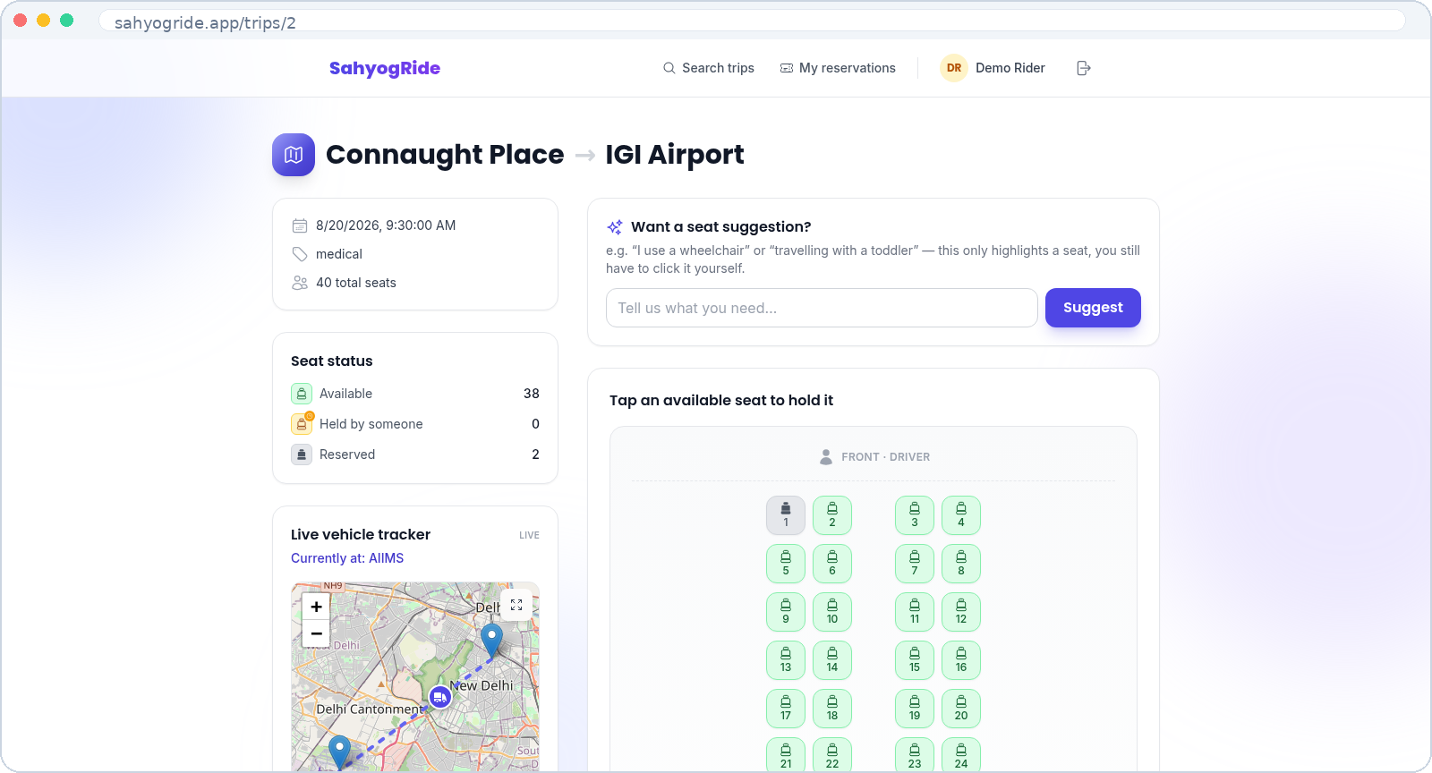
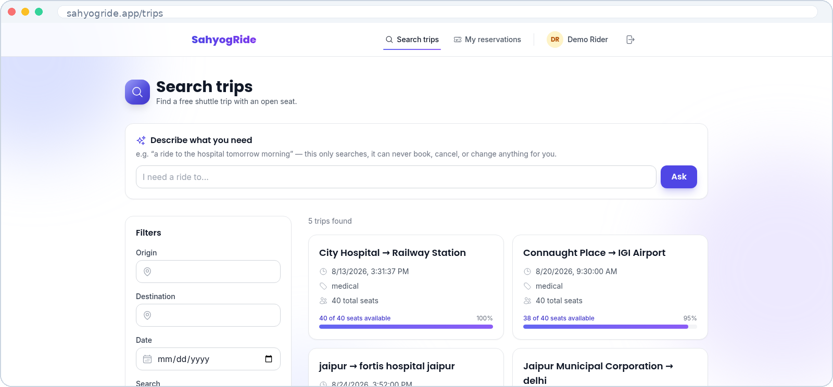
THE PRODUCT
See it in action — searching for a ride
Search, or just ask
A bus you can actually see
Filter by origin, destination, and date — or ask the AI assistant in plain language. It only searches, never books.
Every seat is a chair icon, not colour alone, so status is clear at a glance — live for everyone, updated every 5 seconds.
SahyogRide — Team 078
13

Slide 14
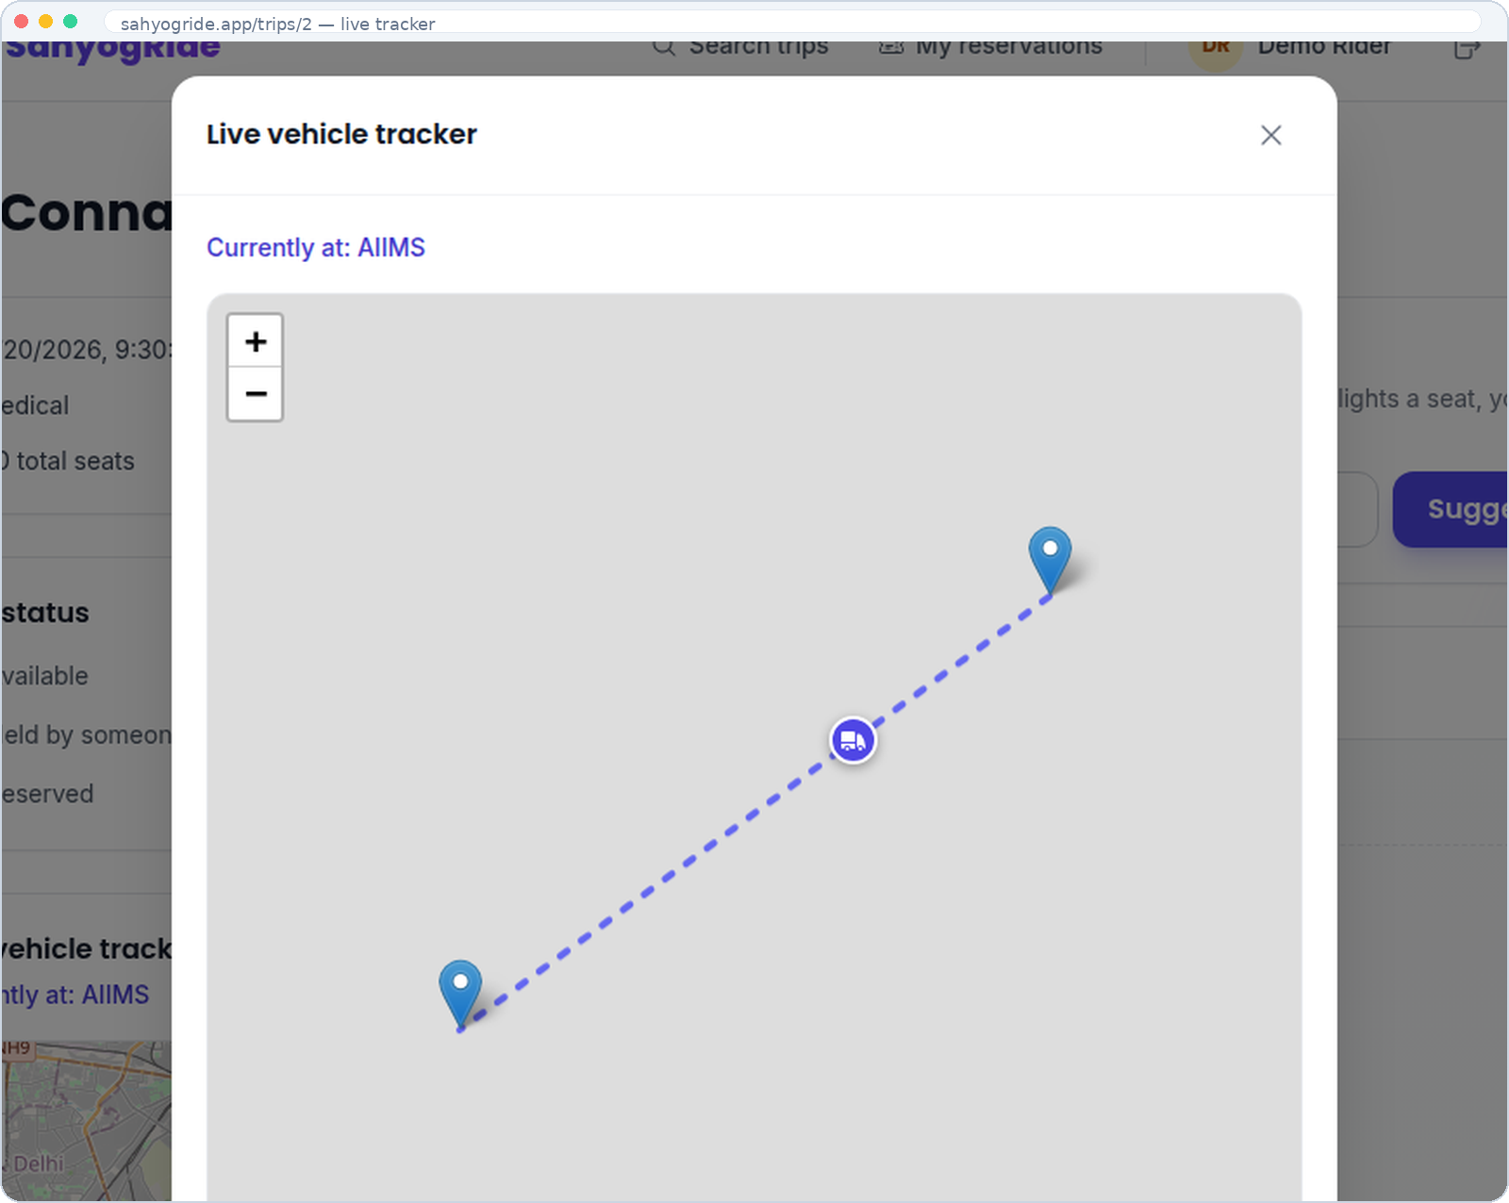
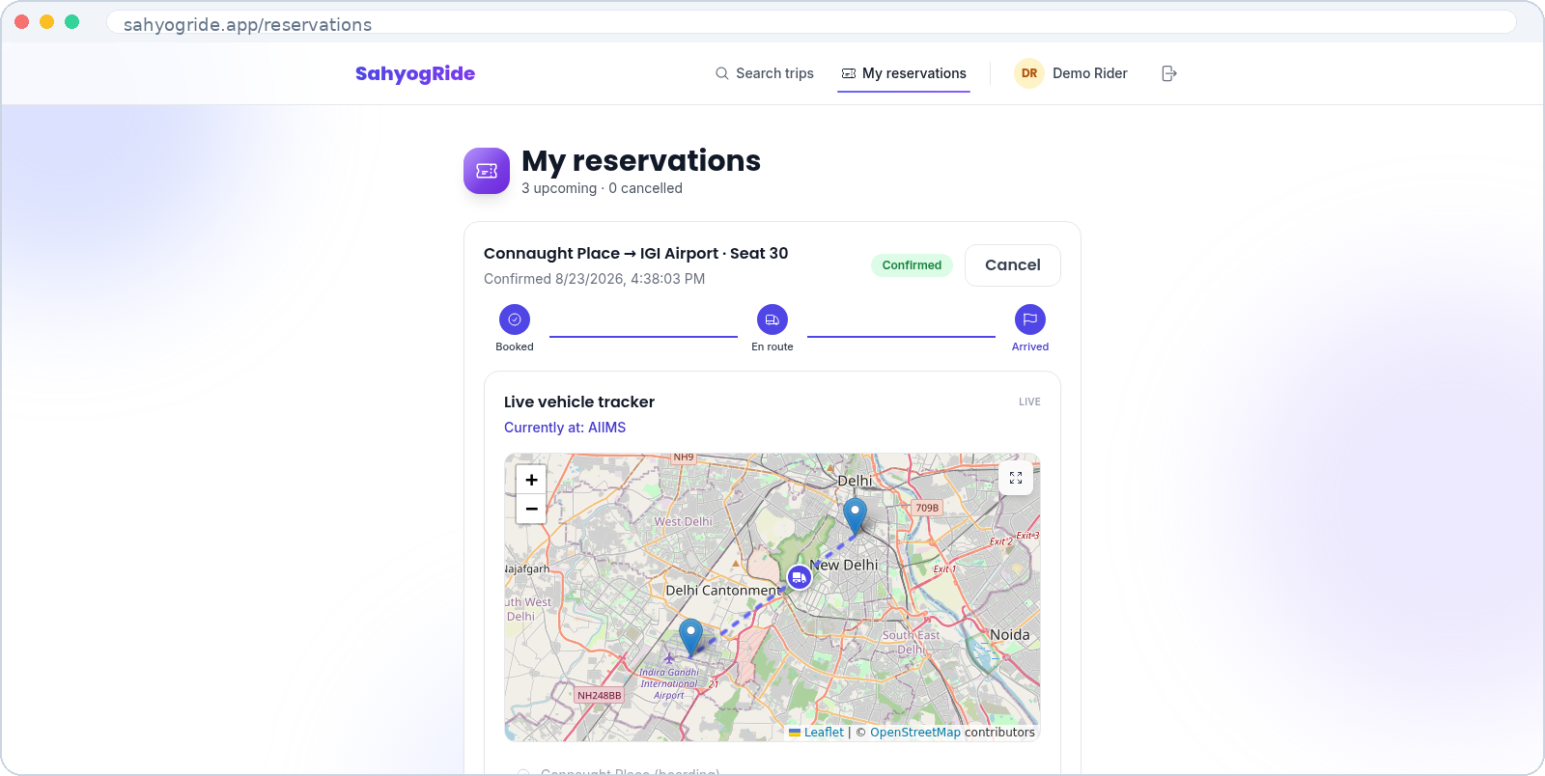
THE PRODUCT
Live tracking, from booking to arrival
One place for every booking
Zoom in on the route
A status timeline and a live map sit on every confirmed reservation — no more calling to ask “where's the van?”
The coordinator marks the real stop; the marker eases between stops for every viewer — live, never a fake animation.
SahyogRide — Team 078
14

Slide 15
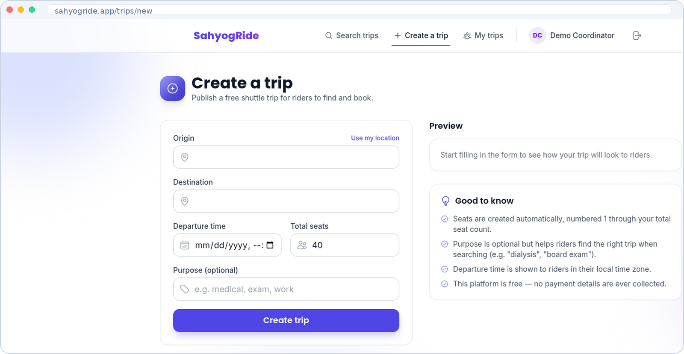
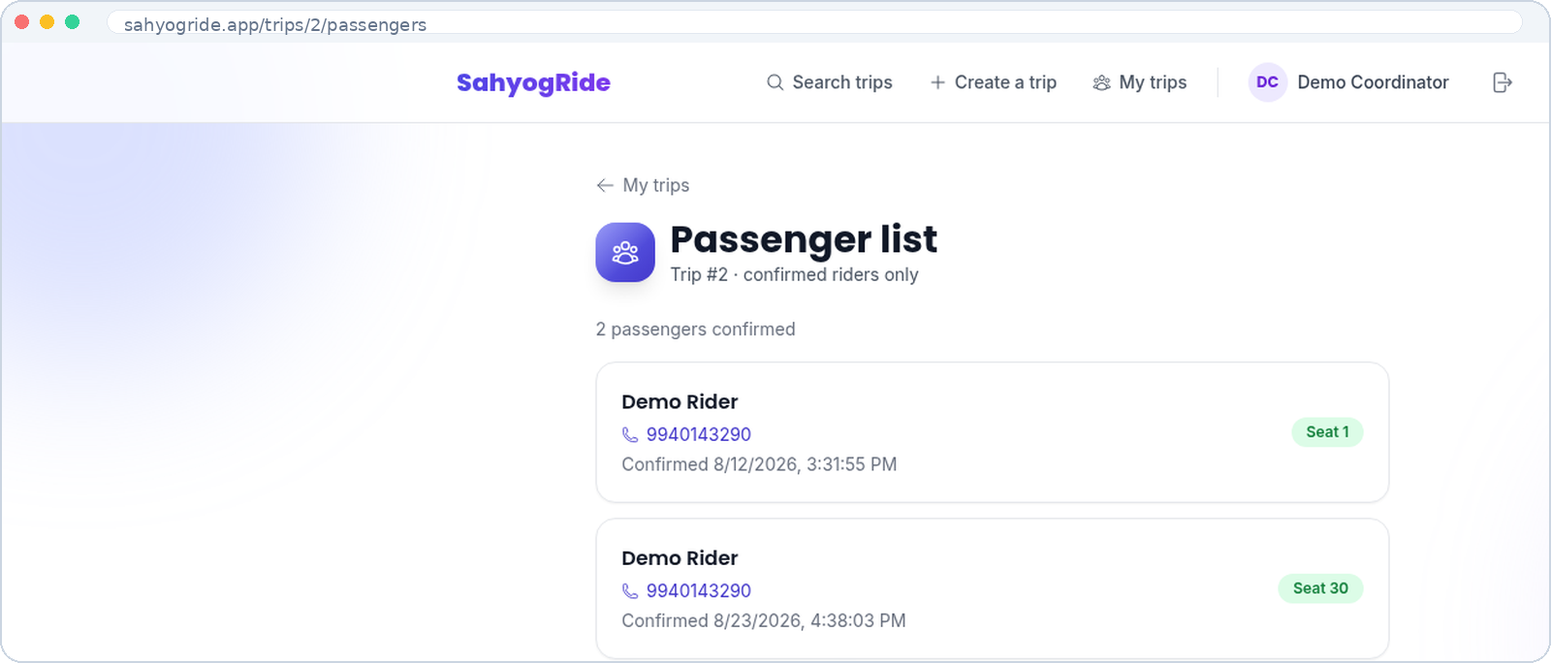
THE PRODUCT
Built for the people running the trip
Publish a trip in seconds
Know exactly who's coming
Route, time, and capacity — seats generate automatically and the trip is instantly searchable by riders.
A real-time passenger list with contact numbers — no phone calls, no spreadsheets, ever.
SahyogRide — Team 078
15

Slide 16


UNDER THE HOOD
A simple, three-layer architecture
Frontend
Backend & Data
AI Layer (isolated)
React 18, Vite, Tailwind CSS
FastAPI + SQLAlchemy 2.0
One isolated service module
TanStack Query for live data
PostgreSQL 15 + pgvector
5-second timeout, fails to null
Framer Motion animations
JWT auth, bcrypt hashing
Zero write power, ever
Leaflet maps, OpenStreetMap
Alembic — reversible migrations
Works fully with AI off
SahyogRide — Team 078
16

Slide 17
UNDER THE HOOD
Six AI features — all optional, all with a fallback
Finding a trip
Booking a seat
After confirmation
Semantic search via pgvector
Smart seat suggestions
AI urgency triage
Matches natural language
From a free-text note
One-line trip summaries
Falls back to keyword search
Plus a rider chat assistant
Accessibility auto-tagged
Every one degrades gracefully — 5-second timeout, never a crash, full booking flow works identically with AI off.
SahyogRide — Team 078
17

Slide 18

UNDER THE HOOD
Zero double-bookings, guaranteed — not hoped for
1. Row-level lock
2. Unique constraint
3. Partial unique index
SELECT ... FOR UPDATE
UNIQUE(seat_id) on holds
UNIQUE seat WHERE confirmed
Locks the seat row
An independent 2nd guard
Database-level backstop
Requests serialise, never race
Holds even if the lock is missed
Never two confirmed seats
Verified by our star test: two riders race for one seat, 50 iterations — always one 201, one calm 409.
SahyogRide — Team 078
18

Slide 19

Thank You
SahyogRide replaces WhatsApp chaos with reliable, real-time seat management —
built from real conversations with the people who need it most.
TEAM 078
Vibhav Shukla (Lead)
Siddharth Kumar Yadav
Nilesh Mehra
Navneet Kumar Yadav
Aakash Kumar Katha
Venkatesh Ramakrishnan
SahyogRide — Team 078
19

